Slide 1
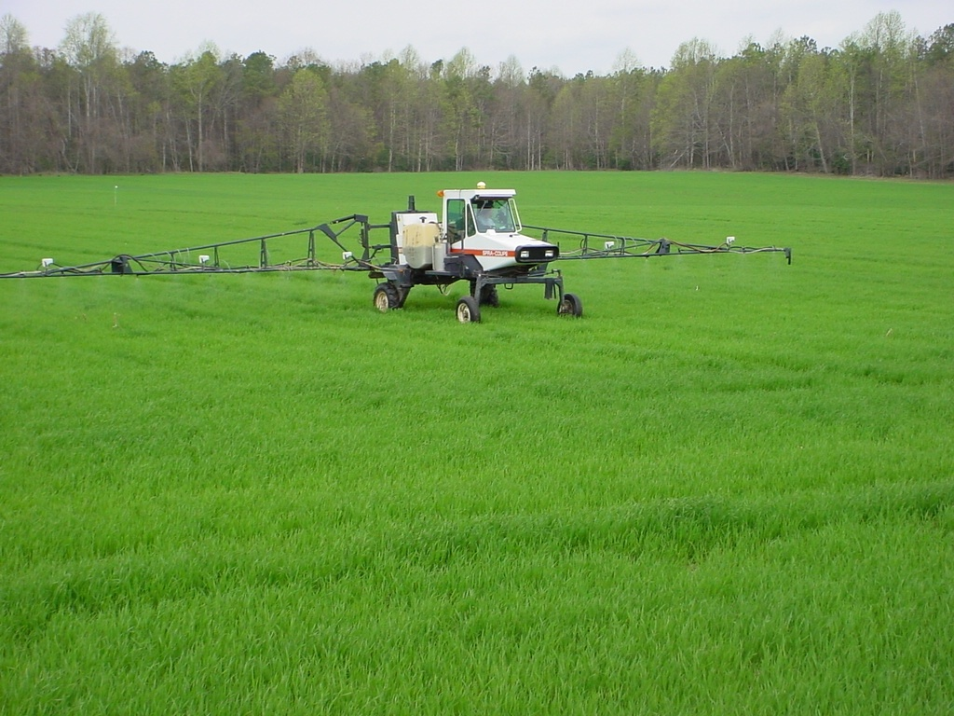

Variable-Rate N Fertilization of Wheat and Corn
in the Mid-Atlantic
Wade Thomason, VT
Steve Phillips, IPNI
Paul Davis, VCE retired
Mark Alley, VT
Mark Reiter, VT

Slide 2
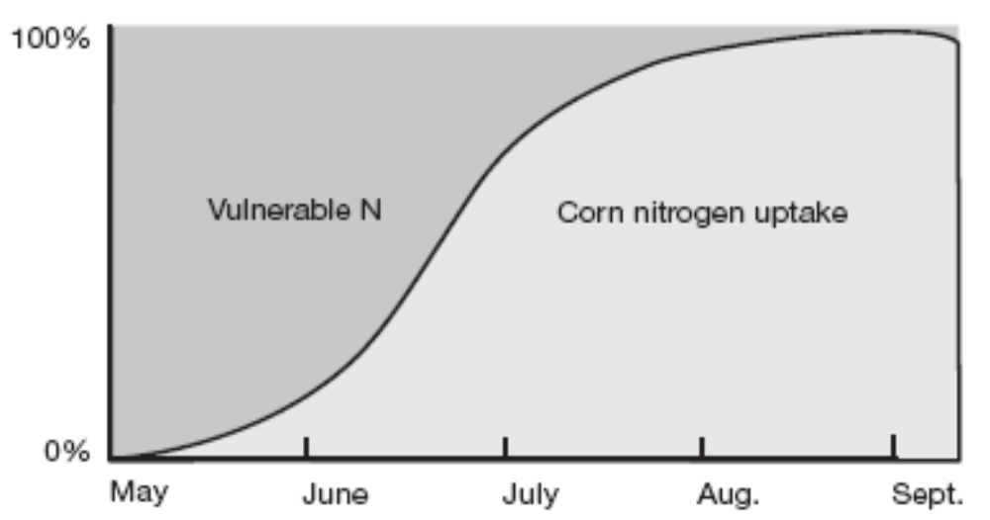
INCREASING N FERTILIZER EFFICIENCY
Match Timing of Fertilization with Crop Demand
  But… if it’s been a wet early summer…
  … if it’s been a dry early summer…
More Knowledge of Crop N Need
  1 lb N/bu of expected yield

Slide 3
TEMPORAL VARIABILITY

Slide 4
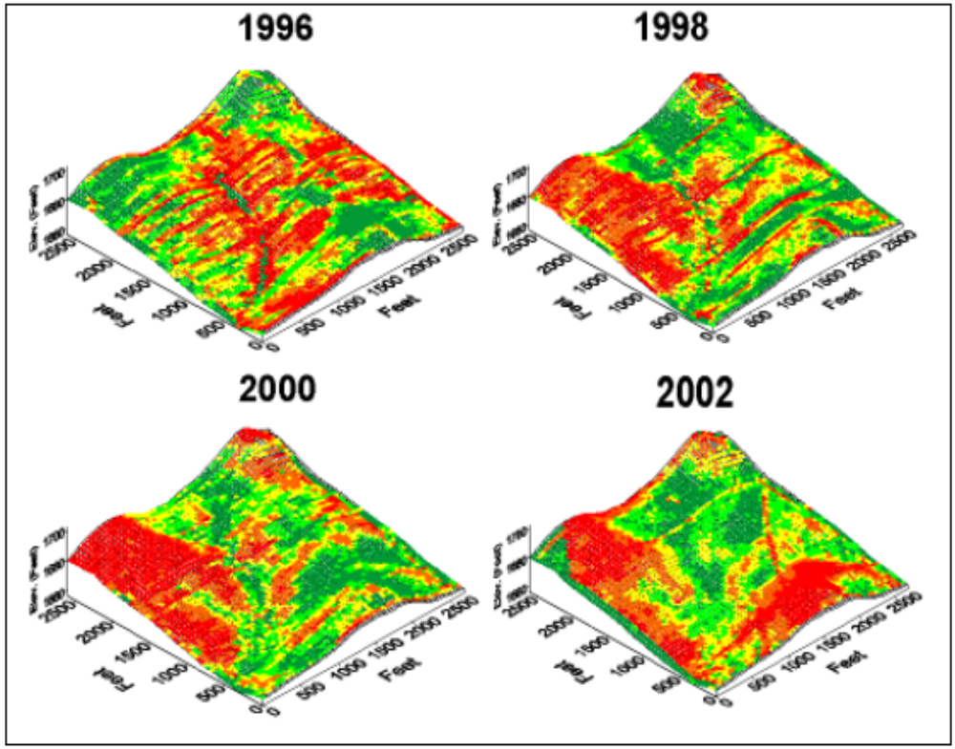
TEMPORAL VARIABILITY

Slide 5
SPATIAL VARIABILITY
60 acre field in Caroline County
Wheat yields: 44 to 80 bu/acre
Corn yields: 85 to 178 bu/acre
Bojac 1A
Wickham 4A
Wickham 3A
Bojac 2A

Slide 6
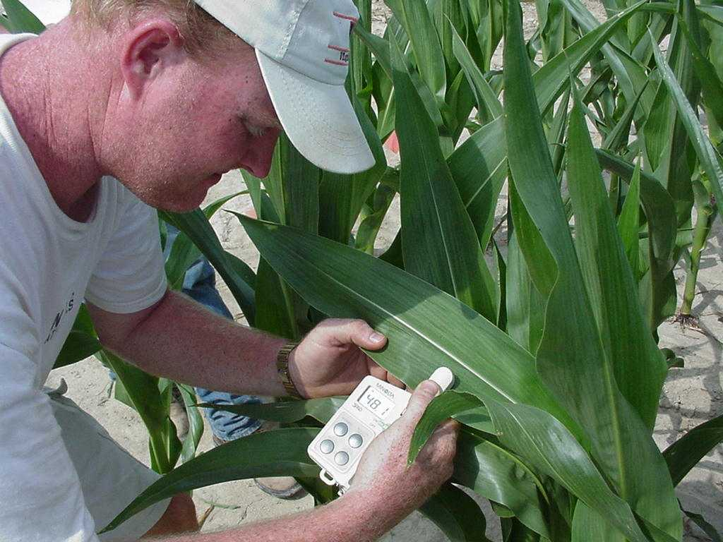
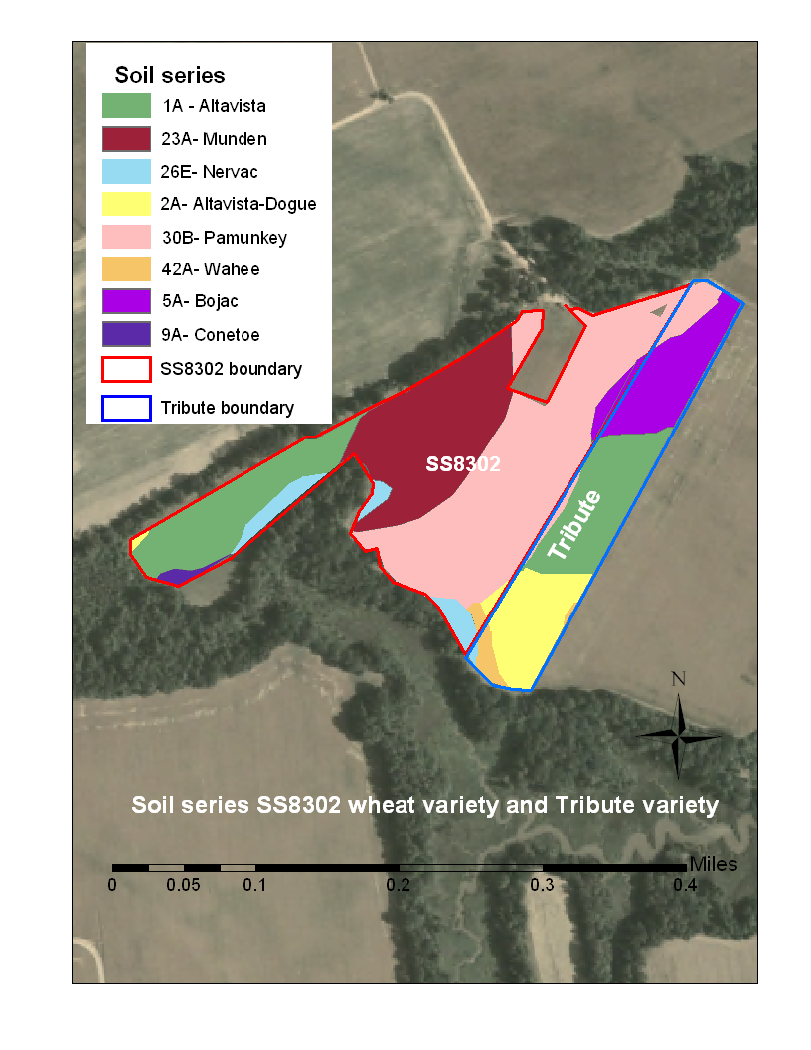
ADDRESSING THIS VARIABILITY
Temporal
  Shoot from the hip
  PSNT
  Tissue tests
  Chlorophyll meter
  Precision Ag Technologies
Spatial
  Soil map
  Yield/History map

Slide 7
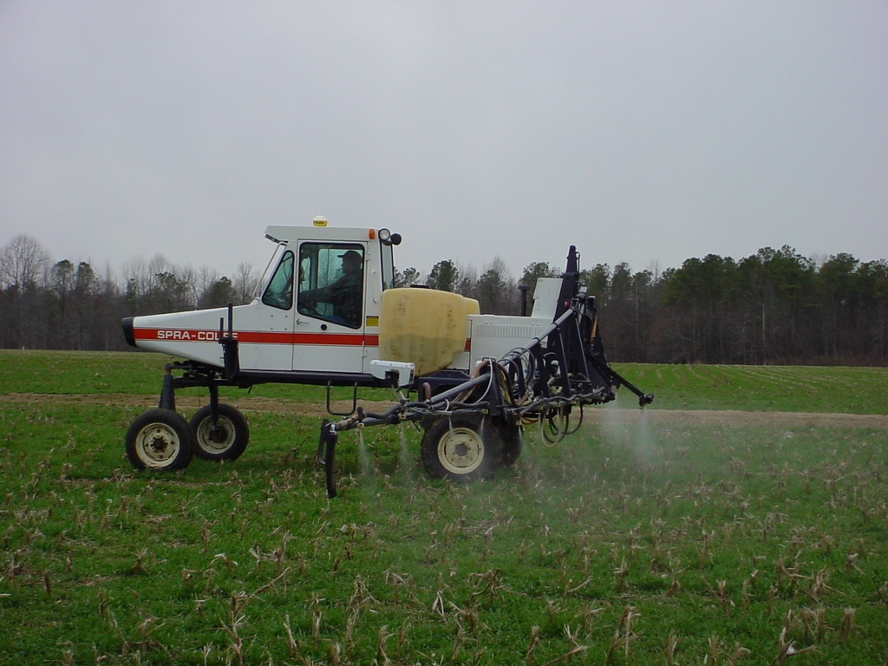

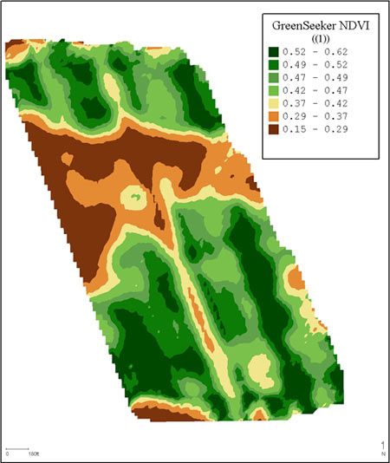
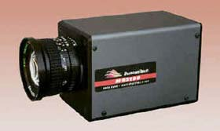
Why?

Slide 8
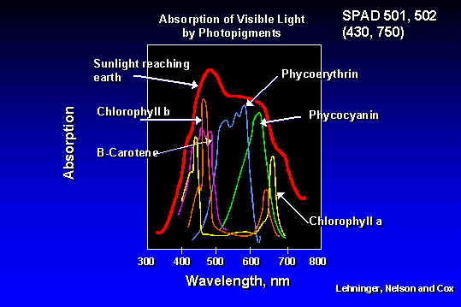

Slide 9
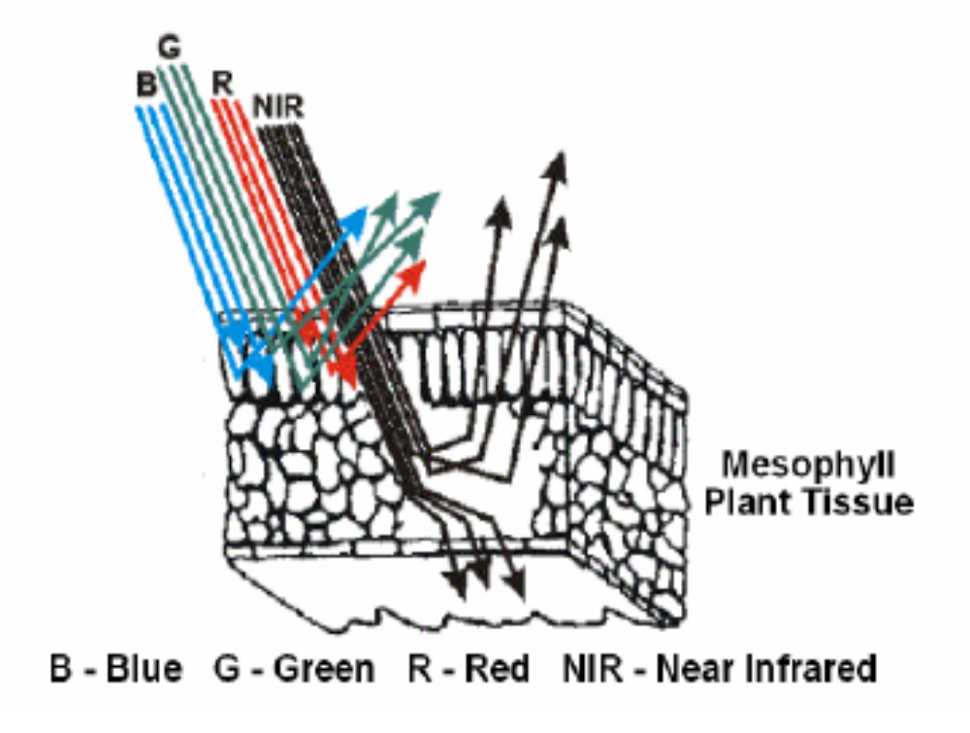
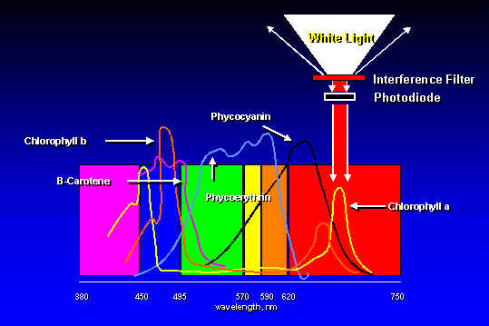
RED light absorbed = Green light reflected

Slide 10
Normalized Difference Vegetative Index
NDVI => Calculated from Red and NIR Reflectance

Slide 11
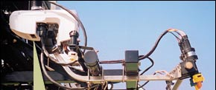
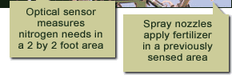
Sensor Function
Light signal
?
Calculate NDVI
?
Lookup valve setting
Valve settings
Light
Light
?
Apply valve setting
Valves and
Nozzles
detection
generation
?
Send data to UI
“Sensor”

Slide 12
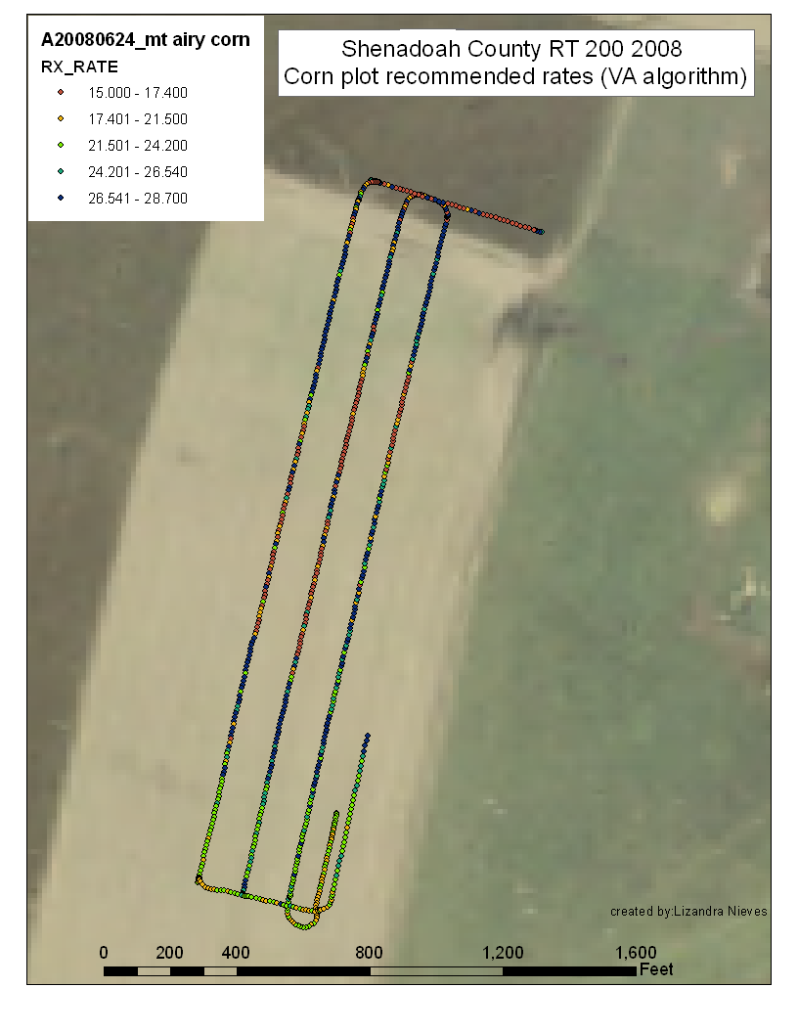
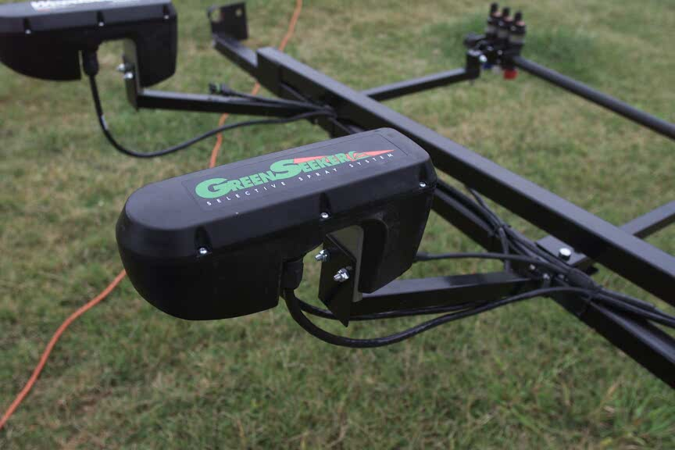
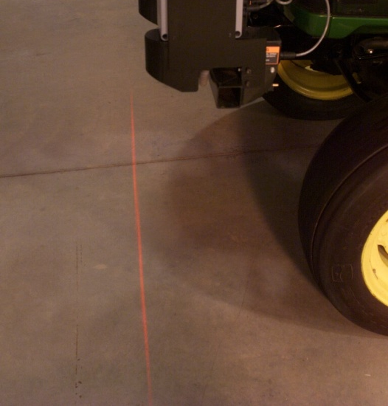
OPTICAL SENSORS
Measures spectral reflectance in a 3/8” x 24” area
Samples at a frequency of 60 times/sec
Average reflectance measurements calculated every second

Slide 13
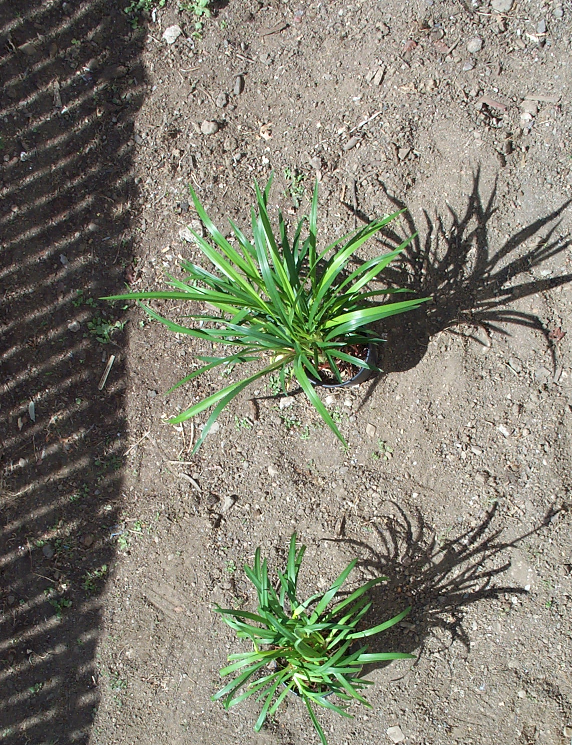

What the Sensor “Sees”
The vigor of the leaves and
the ratio of plant to soil
affect NDVI values
The vigor of the leaves and
the ratio of plant to soil
affect NDVI values

Slide 14
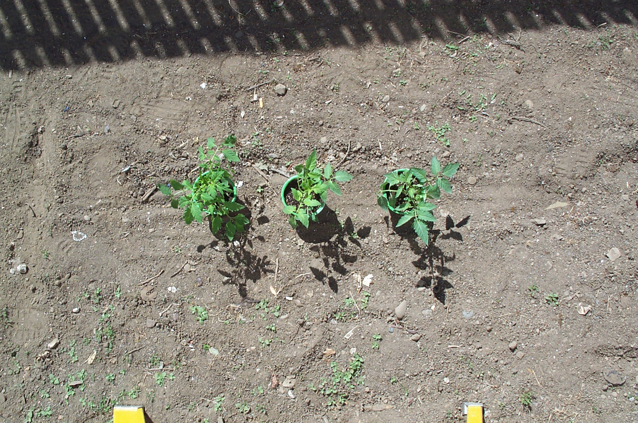
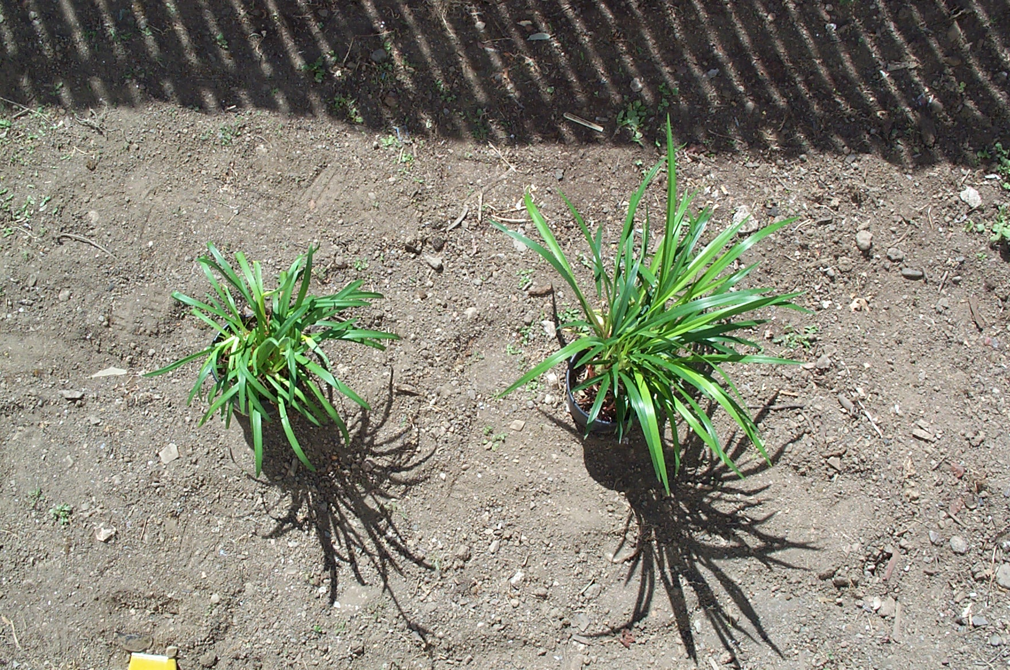
Note that the biomass of each plant is observable in NDVI value

Slide 15
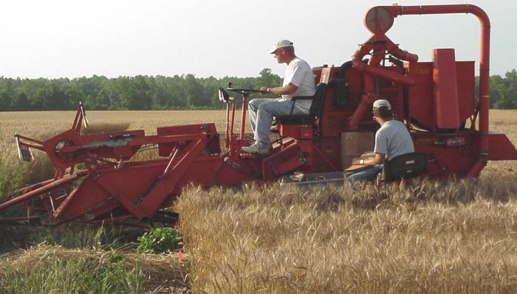
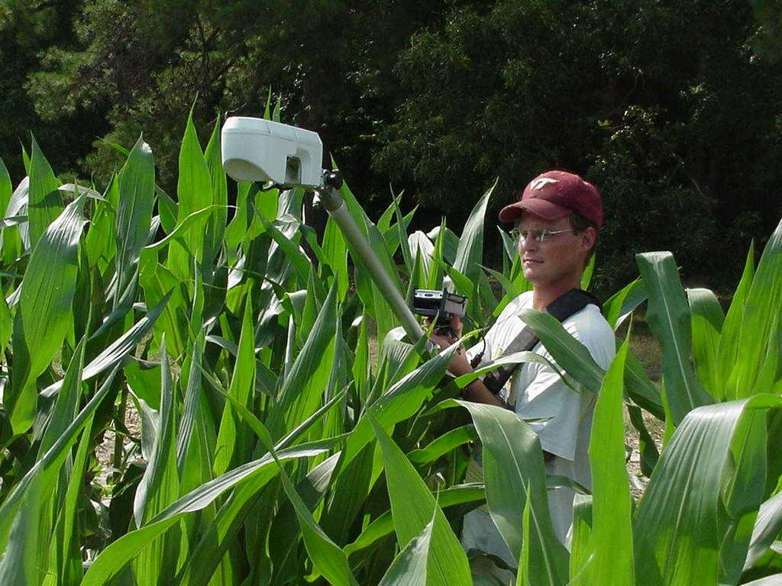
BACKGROUND
~60 sites across Virginia since 2000
Irrigated and non-irrigated
Conventional and no till
Various rotations, hybrids, varieties, and soil types
Wide range of preplant, starter, and in-season N rates (including VR)
Collected spectral measurements and an assortment of plant physical and chemical characteristics at various growth stages
Determine grain yield

Slide 16
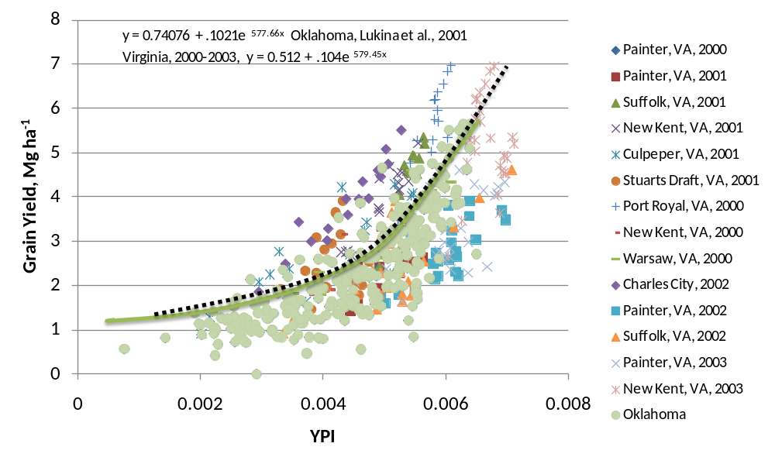
VIRGINIA APPROACH
Generated calibration model for Mid-Atlantic wheat

Slide 17
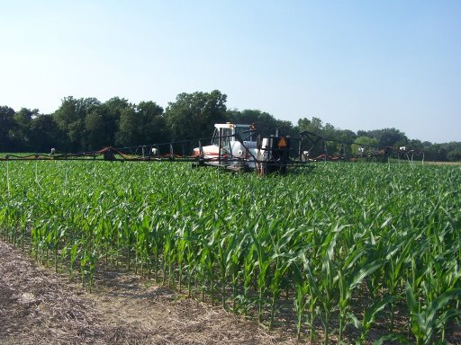
VIRGINIA APPROACH
Generated calibration models for wheat and corn grown in the Mid-Atlantic
Developed N fertilization algorithms for both crops

Slide 18
In-season N management
2nd topdress based on
Tissue N concentration
1st topdress based on
estimated tiller #
30 to 40 lb N/ac preplant

Slide 19
In-season N timing
2nd topdress based on
NDVI and DFP
1st topdress based on
estimated tiller #
Days From Planting
Zadoks stage, in parenthesis

Slide 20



Wheat N Rate Algorithm

Slide 21
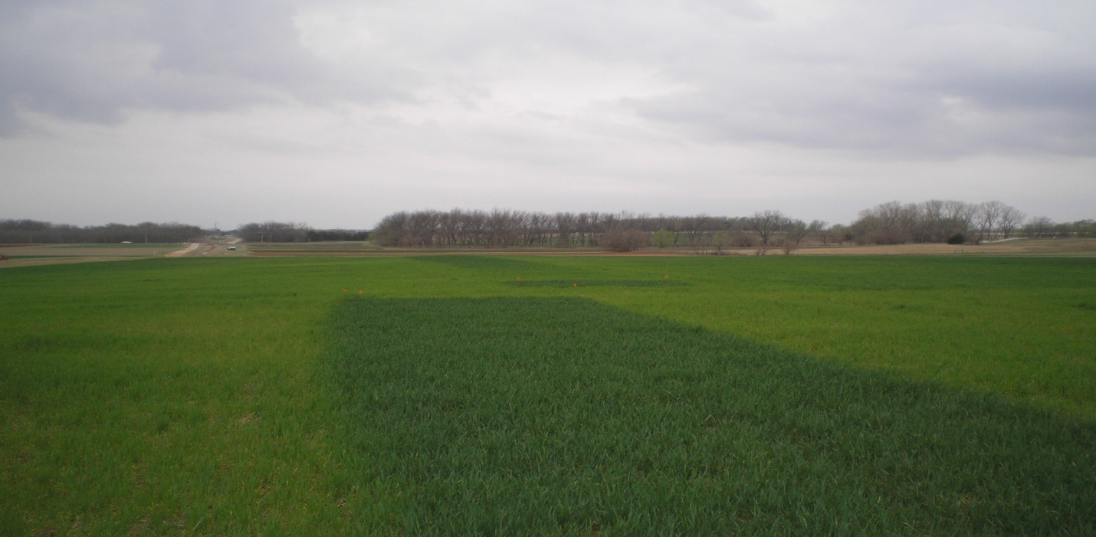
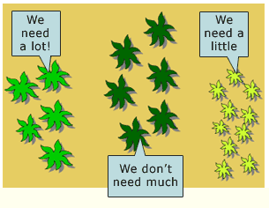
What’s Needed
Reference Strips
  Difference between:
    High N reference (best possible with more than adequate N)
    Low N reference (0 N applied)
    And
    Area currently in sensor’s view.

Slide 22
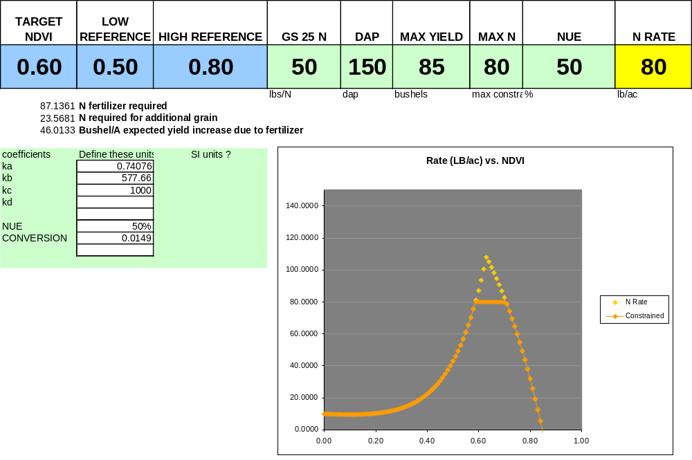
VIRGINIA APPROACH - Wheat

Slide 23
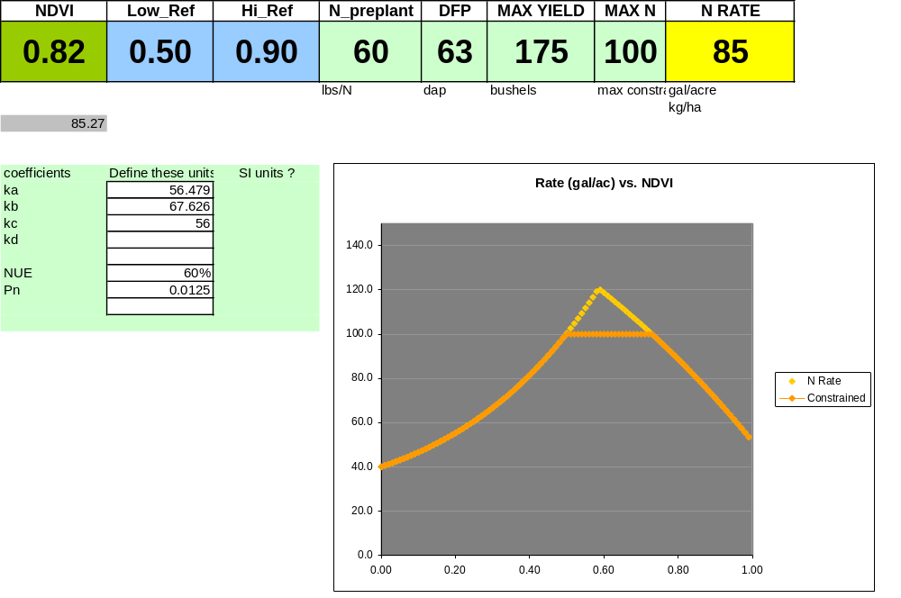
VIRGINIA APPROACH - Corn

Slide 24
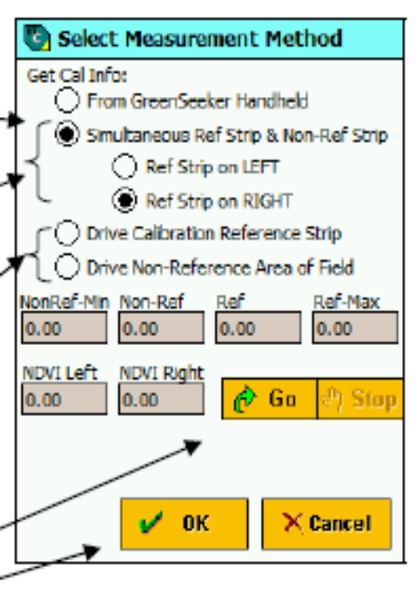
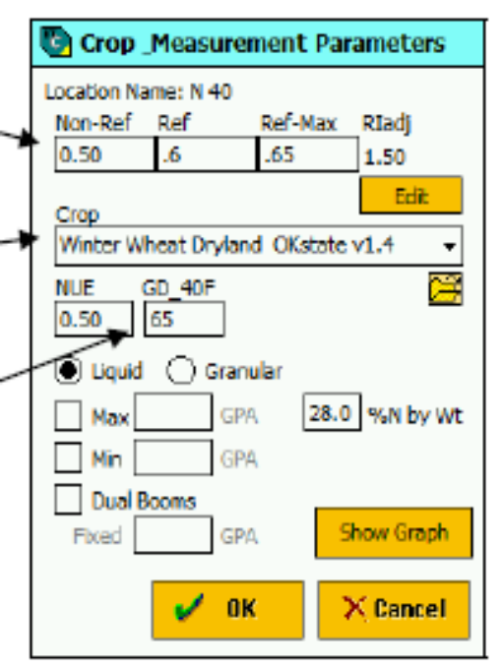
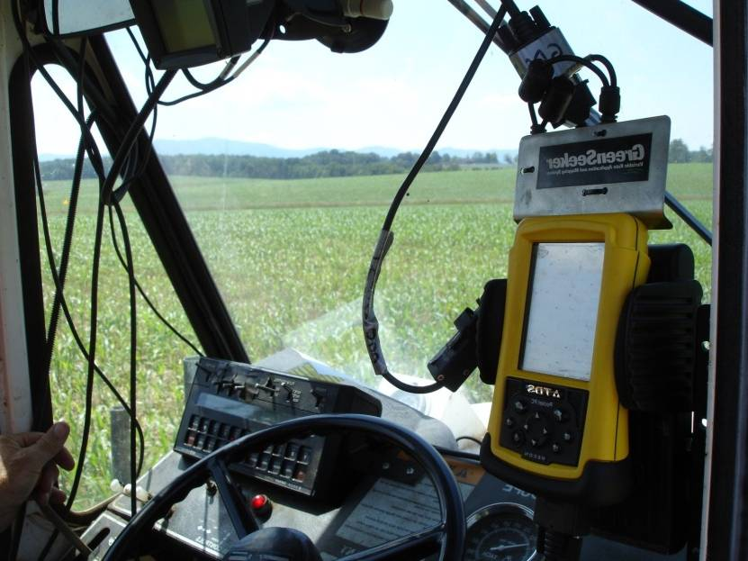
Entering Required Information

Slide 25
VIRGINIA APPROACH
Generated calibration models for wheat and corn grown in the Mid-Atlantic
Developed N fertilization algorithms for both crops
Validated these rate equations for performance

Slide 26
EXPERIMENTAL PROCEDURES
Diverse locs; RCBD; 3-8 reps
Plot size: 60 by 250 to 500 ft
In-season N:
4-5 Fixed Rates
1 Standard Rate
1 Variable Rate
Grain Yield
Spra Coupe 220 w/ 60 ft boom and GreenSeeker RT200
Raven 440 flow rate controller

Slide 27
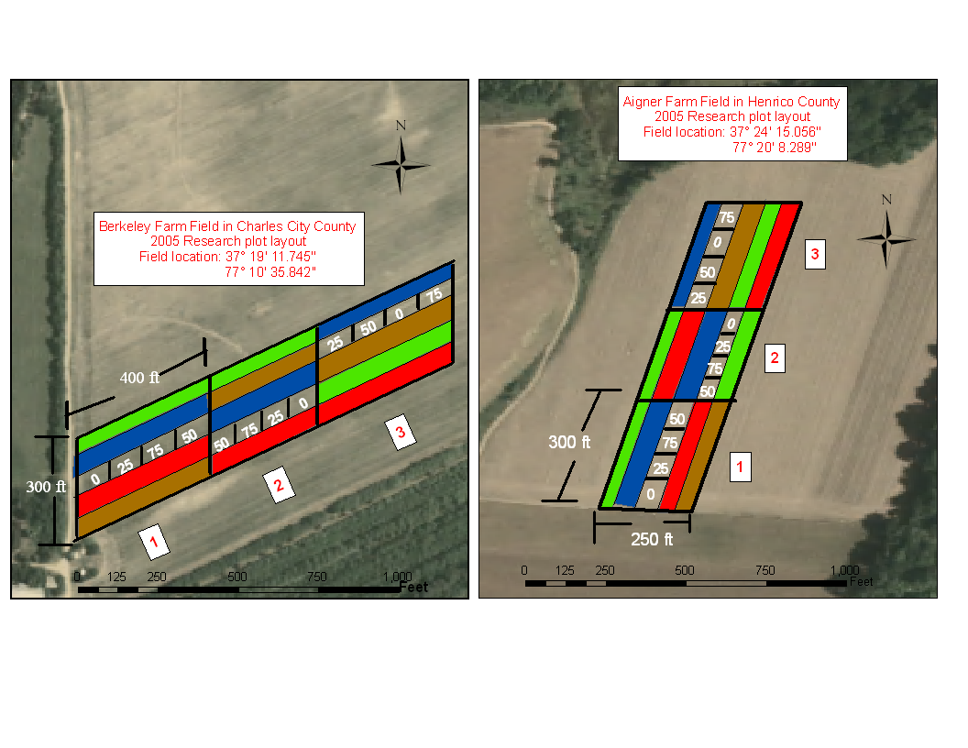
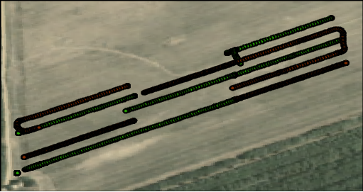
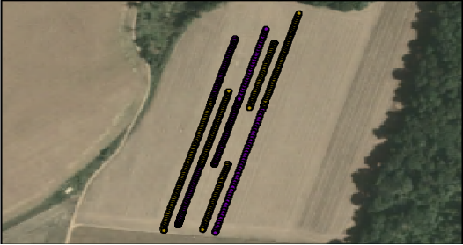
Average: Single N rate determine using Greenseeker® (VA algorithm)
Variable: Variable Nitrogen rate determined using Greenseeker® Virginia Algorithm
Standard: Nitrogen rate determined based on GS 30 tissue test ( Standard Virginia recommendation system )
Greenseeker ® : Variable N rates determined using default Greenseeker ® wheat algorithm
0 – 75 N kg/ha: (numerical rates): Predetermined Nitrogen rates applied in lb/acres
Notes:
Validation – plots are 60’ wide by 300’ long
27

Slide 28
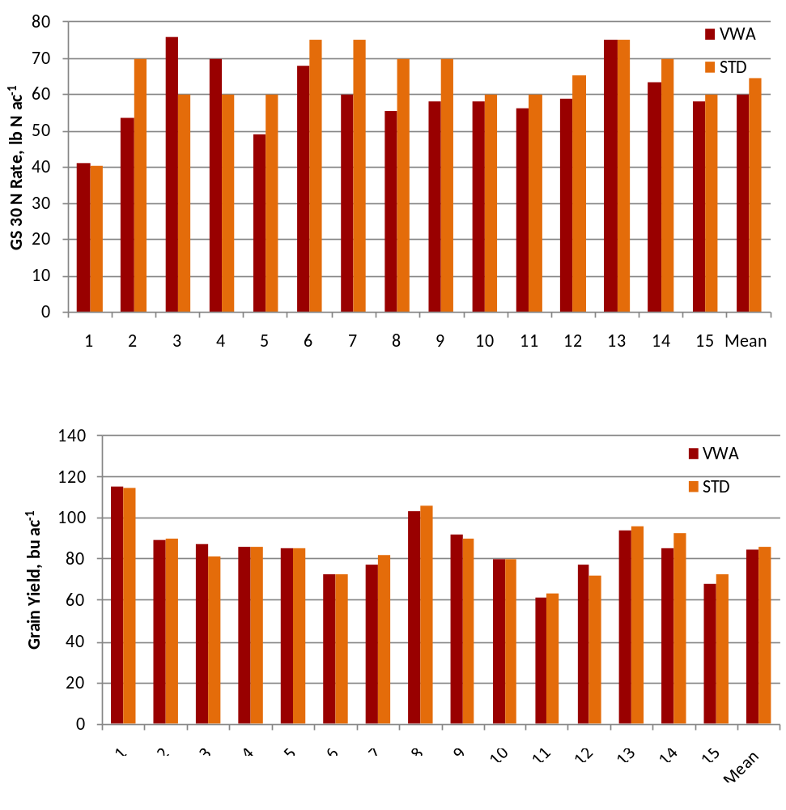
**
**
**
**
**
**
**
*
**
*
*
-7%
-0.8%
*
*

Slide 29
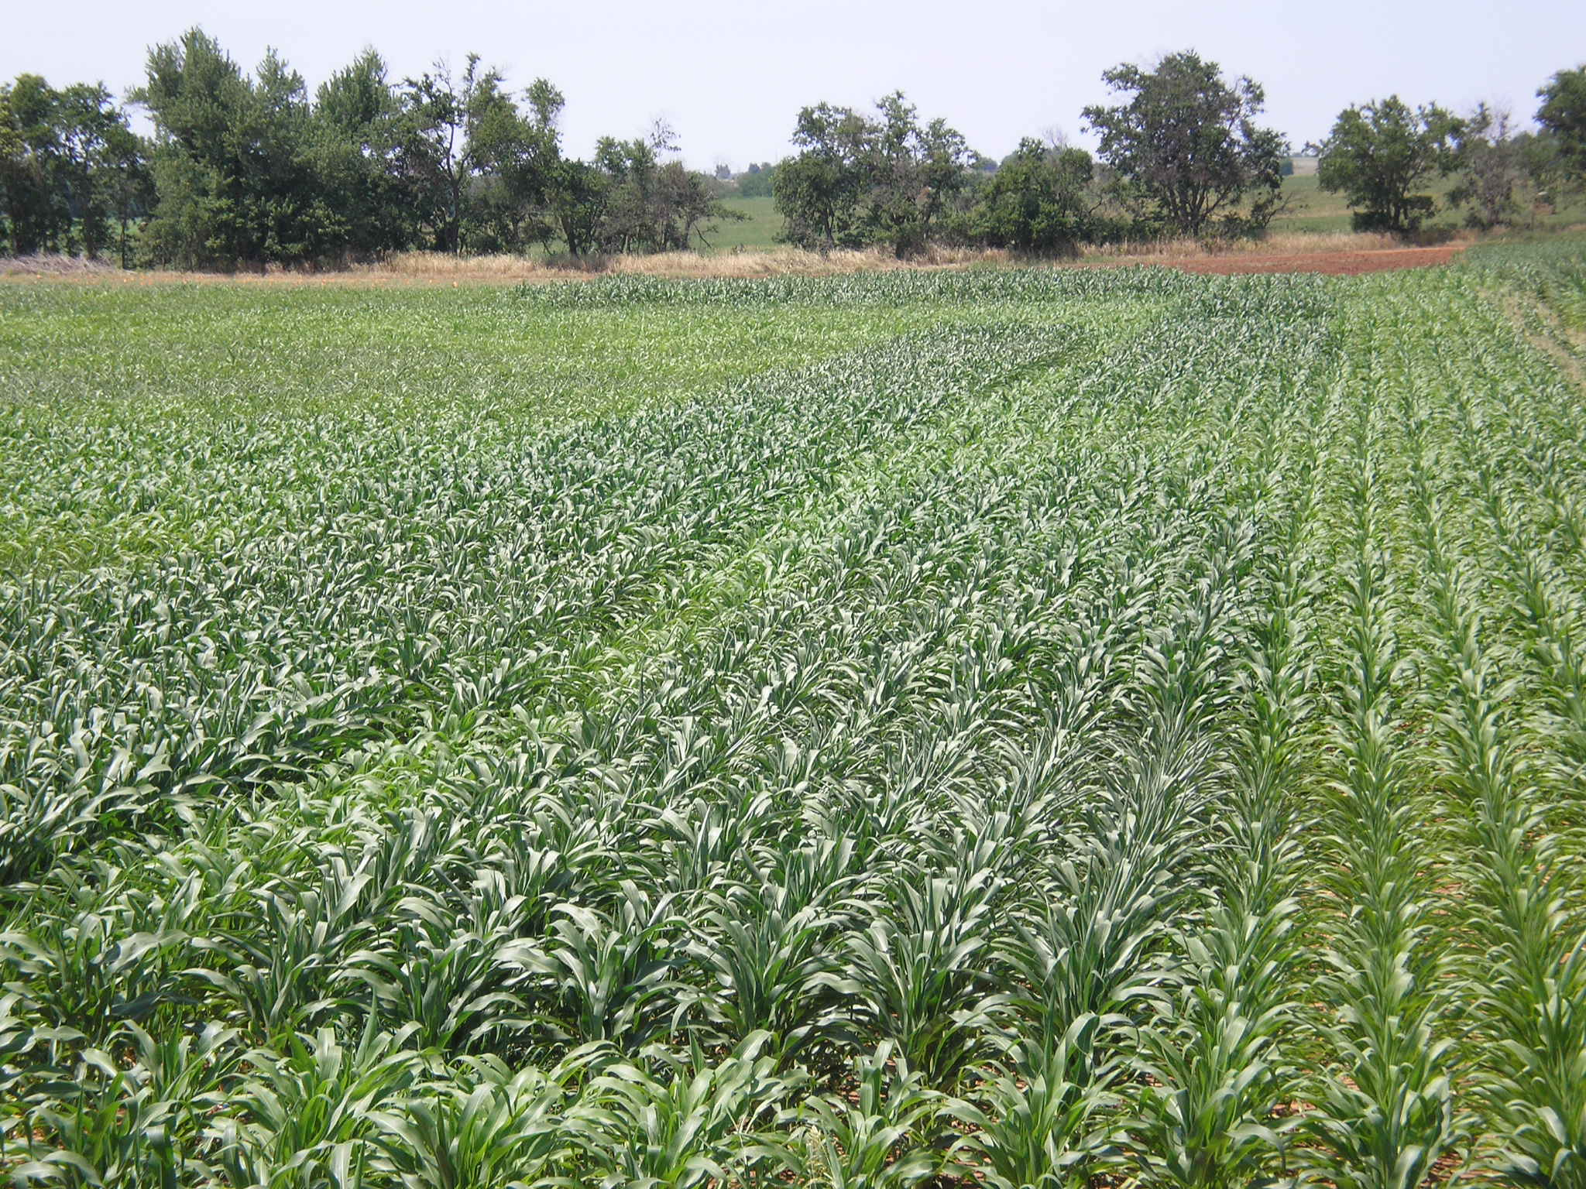
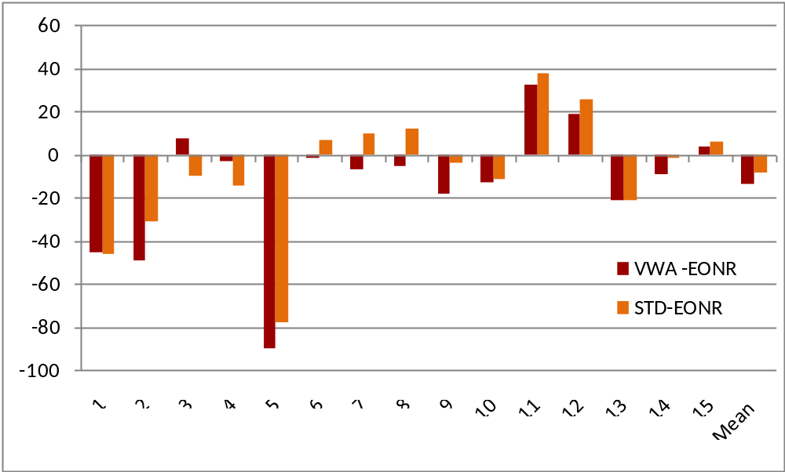
Comparison with Economically Optimum N Rate
*
*
*
*
*
*

Slide 30
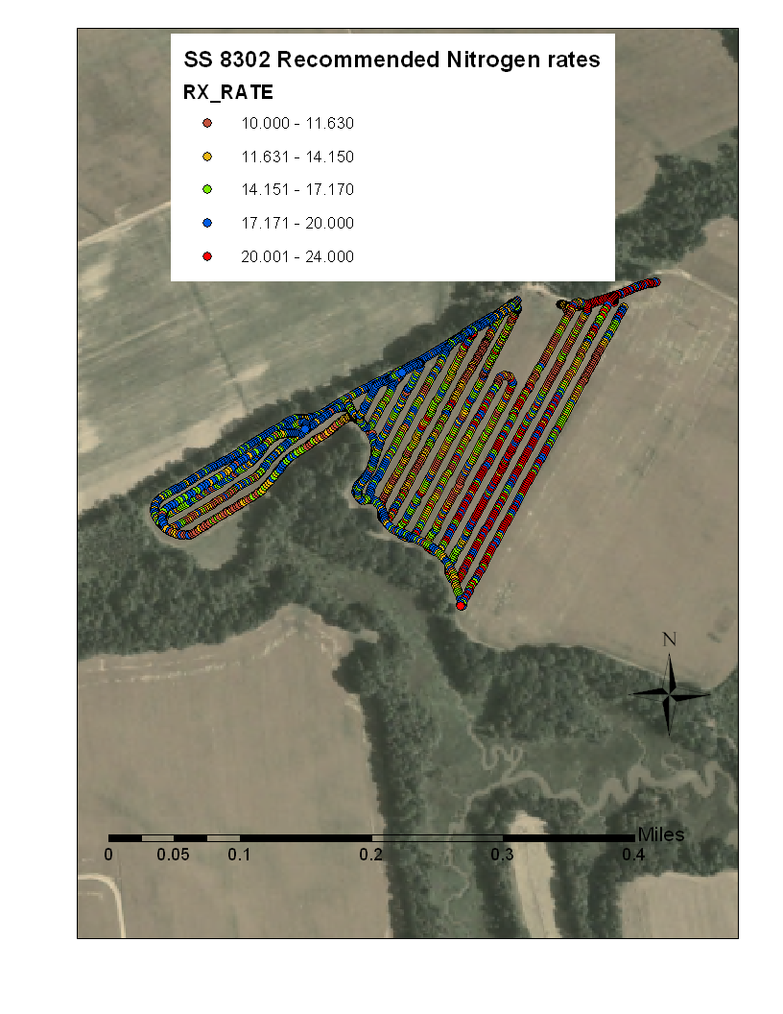
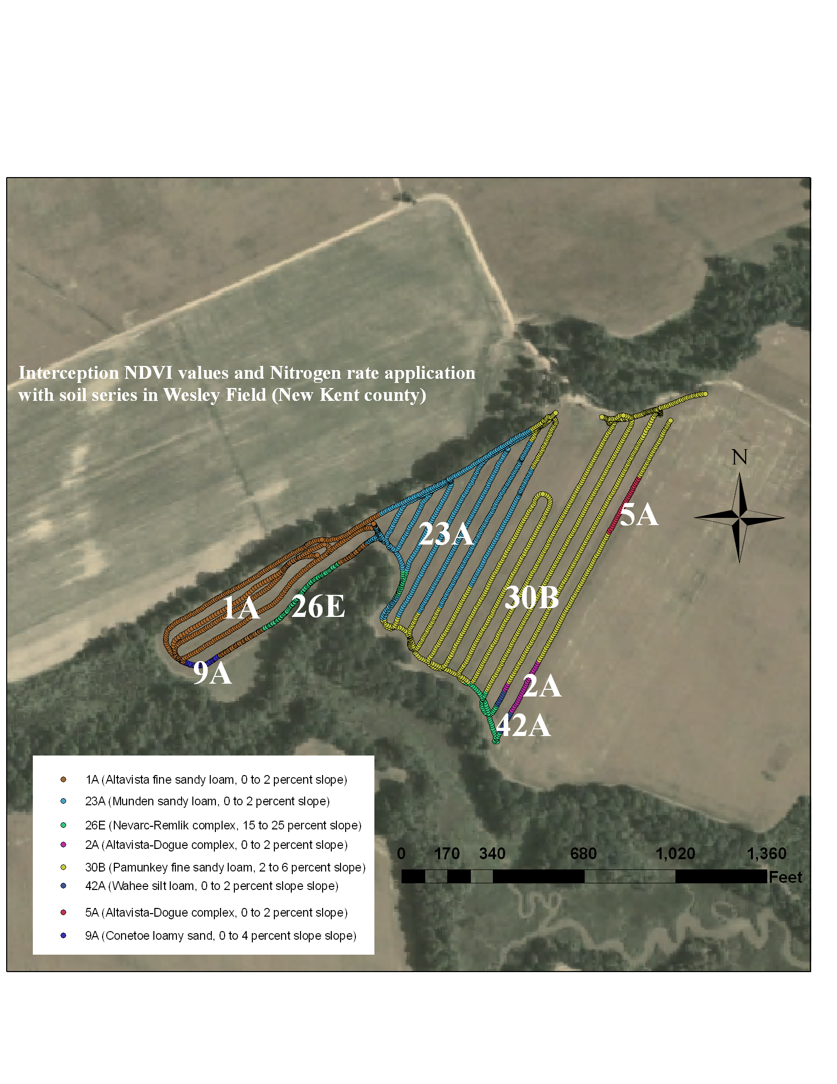
The Rx rate prediction map and real time map demonstrate the small trend in values – SW to NW values almost normal distributed: in the real time map those values ranged from 17 to 20 in the prediction map (interpolation) the recommended rate in that area still normal but decrease to 10 – 12 gal/acres
Notes:
30

Slide 31
Corn Algorithm Performance
120
100
80
N Rate, lb/ac
STD
60
GS
40
20
0
1
2
3
4
5
6
7
8
9
10
11
250
200
191
176
184
173
184
162
161
157
155
163
150
151
150
151
148
Yield, bu/ac
134
132
136
120
119
126
STD
100
95
92
GS
50
0
1
2
3
4
5
6
7
8
9
10
11

Slide 32
Corn Algorithm Performance
NS
160
140
120
21 % (21 lb/ac) less N with GS
100
STD
80
GS
60
40
20
0
Grain Yield, bu/ac
Sidedress N, lb/ac

Slide 33
Ridge and Valley Sites

Slide 34
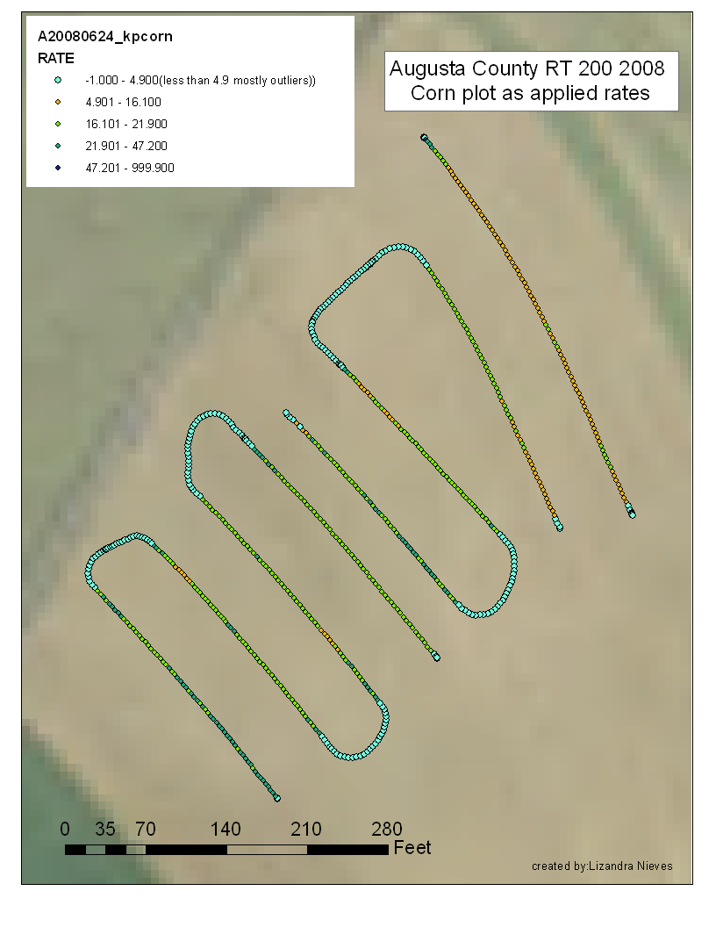
Surface-applied
Manure
72 lb N/ac
72
70
61 lb N/ac
Injected
Manure
70
78
75
63
60
47

Slide 35
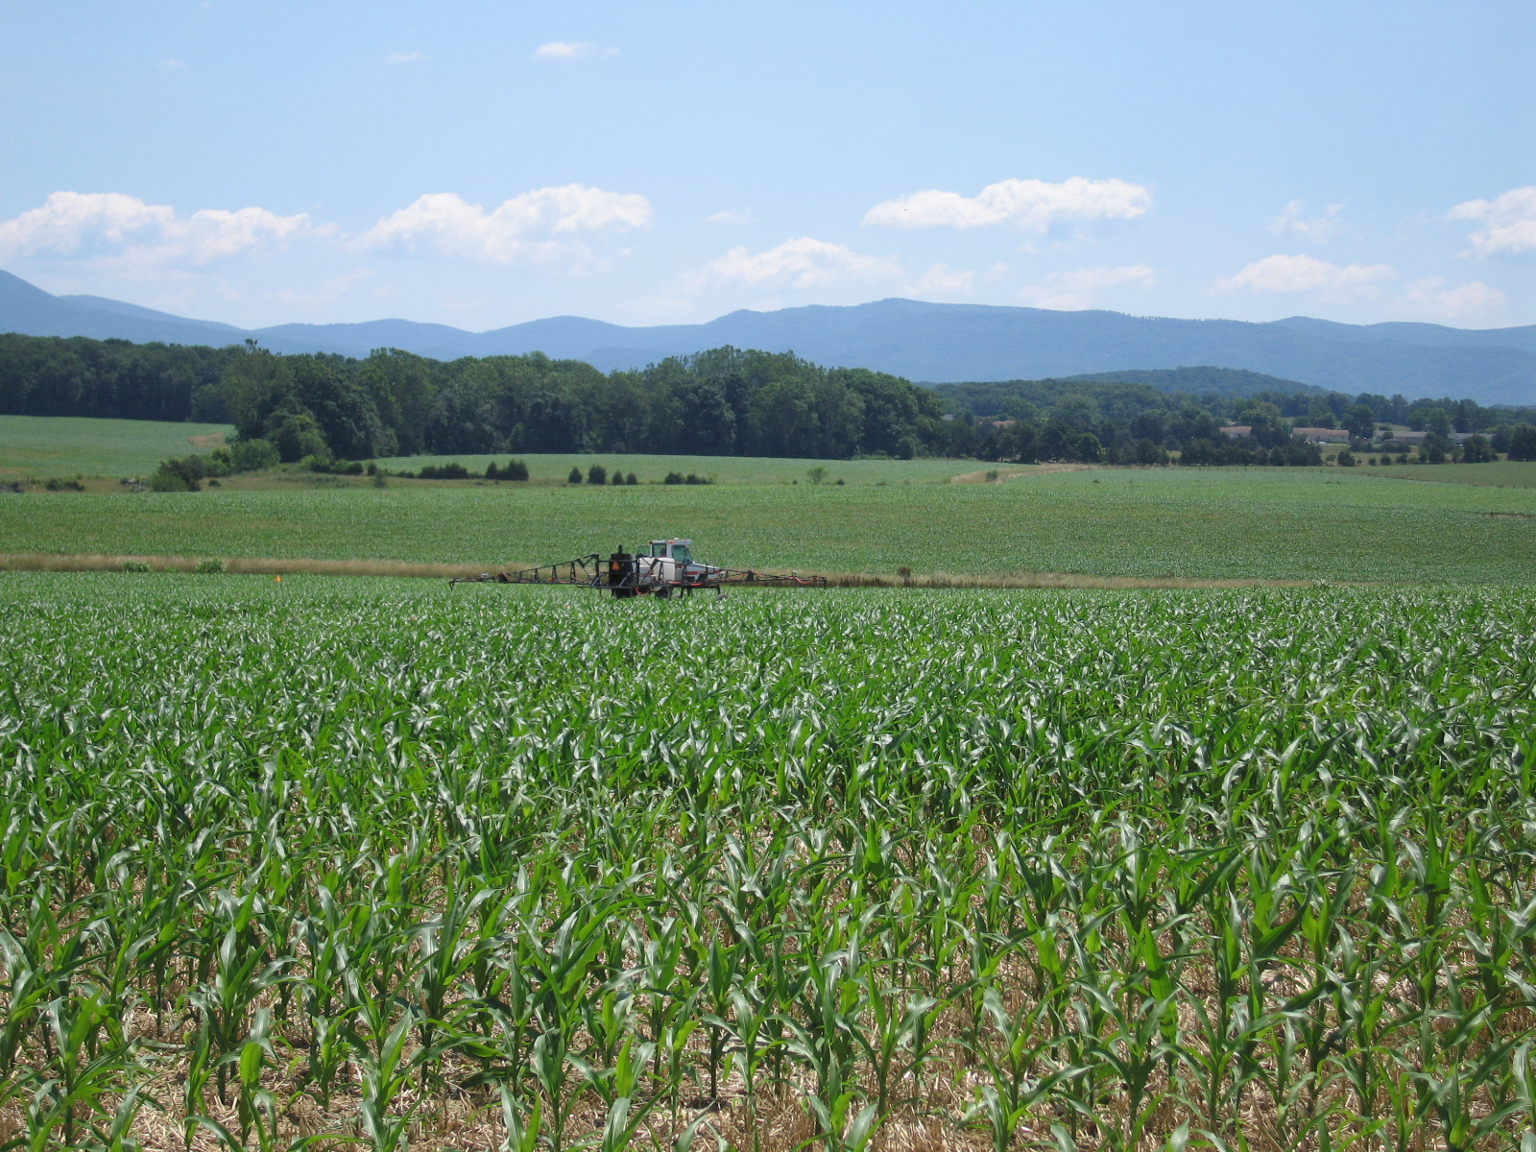
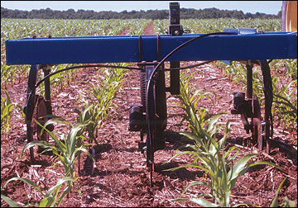
Challenges
Timing
  Size of the corn

Slide 36
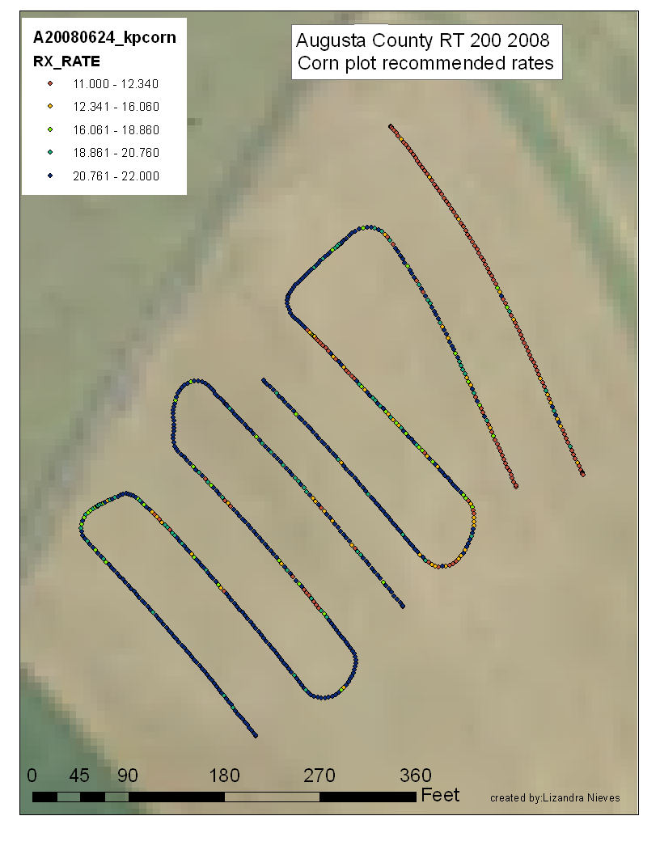
RX vs. Applied Rates
Notes:
55% of points are within 2 gal of prescribed rate
88% of points are within 5 gal of prescribed rate

Slide 37
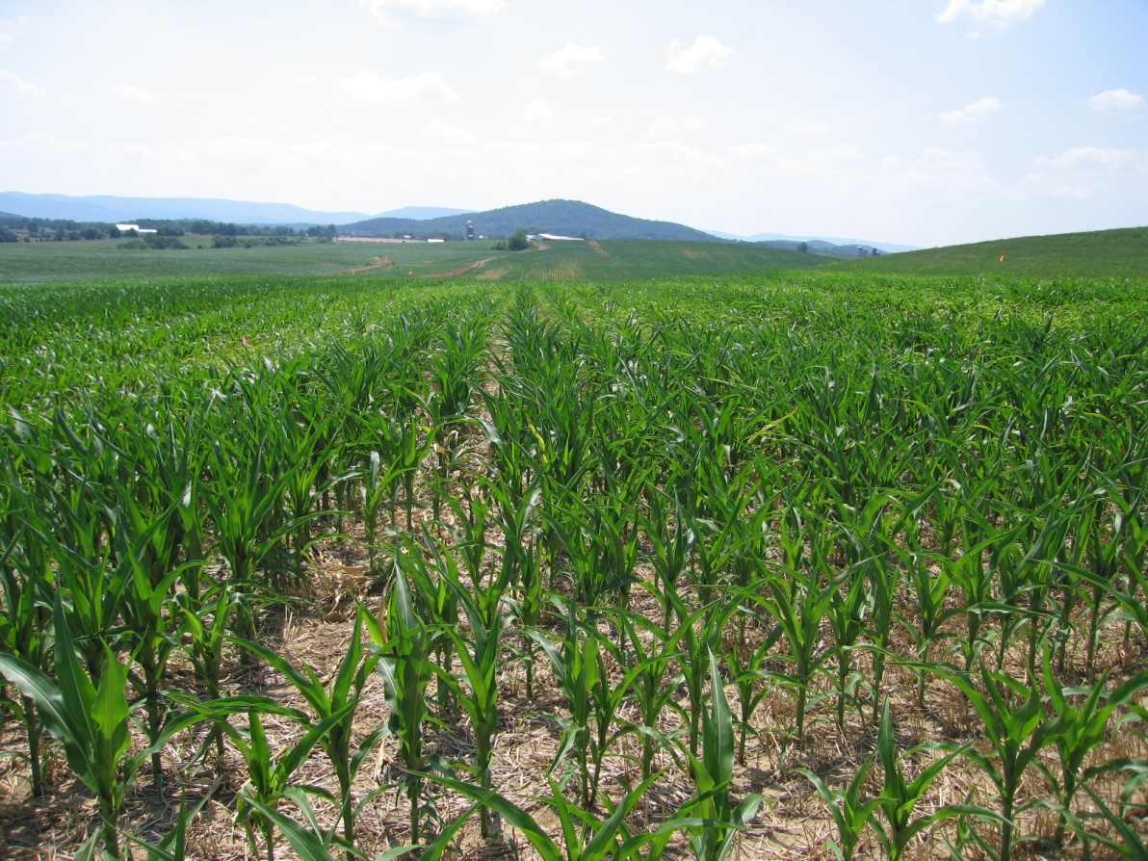
Challenges
N rich strips
  Timing
  Same Field
  Same Hybrid/Variety
  Mark it!
N “poor” strips
NDVI | Low_Ref | Hi_Ref
0.65 | 0.60 | 0.79

Slide 38
Challenges
Herbicide Applications

Slide 39
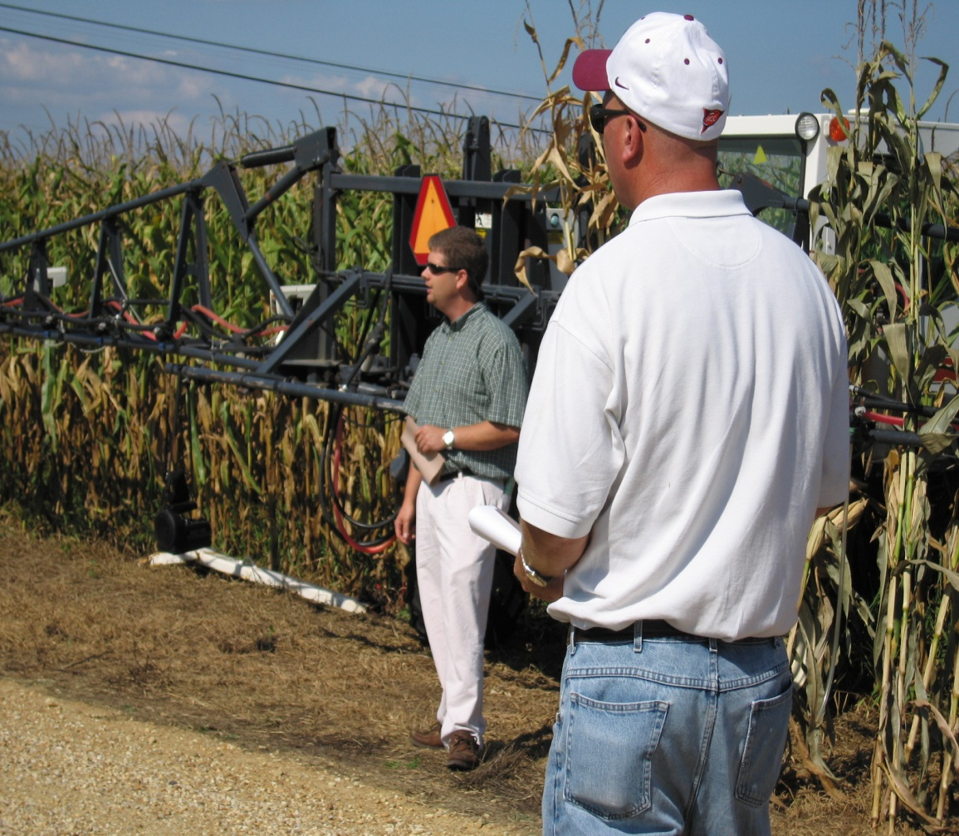
Challenges
Skepticism
How to tell if the system was “right”
Risk
Cost
  EQIP cost share
  Tax credits

Slide 40
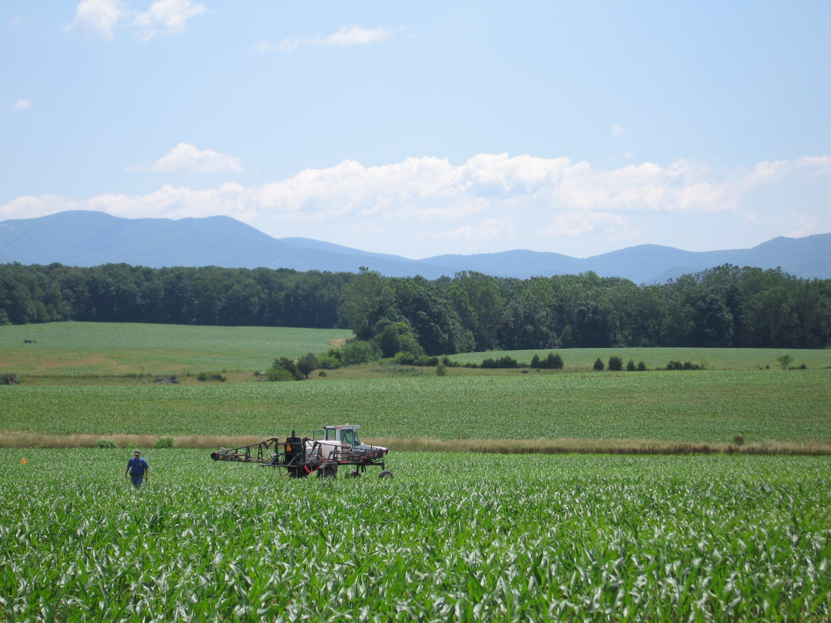
Questions?

